Slide 1
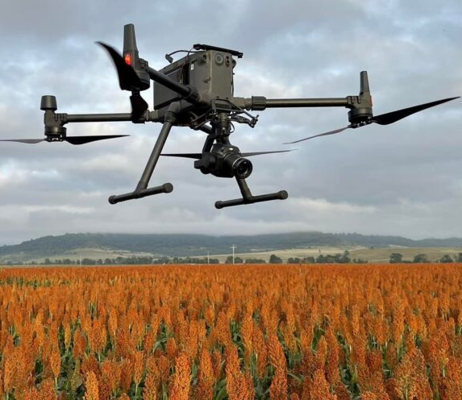
Task1: Real-Time Image Retrieval & Cloud Transmission System on Raspberry Pi
DPIRD-ImageSync APP Development
Presenter: Haitian Wang
Date: 17/03/2025

Slide 2
Project Overview
Goal: Develop a C++-based system on Raspberry Pi 5 to retrieve images from DJI M300 RTK in real-time and upload them to Pawsey S3 storage.
Key Components:
DJI M300 RTK Drone + ZENMUSE P1 Camera
Raspberry Pi 5 + Wi-Fi 6 Module (Intel AX210NGW)
DJI Payload-SDK (PSDK) & Onboard-SDK (OSDK)
Pawsey Acacia S3 Cloud Storage
Docker for Deployment & Portability

Slide 3
System Architecture
Hardware Setup & Connectivity:
Raspberry Pi 5 ↔ DJI M300 RTK (via E-Port Playboard)
Wi-Fi 6 (AX210NGW) ensures high-speed image transmission
UART (FT232) for serial communication with E-Port
Software Stack:
C++ Application for image retrieval & transmission
DJI PSDK & OSDK API for drone interaction
Docker-based deployment for cross-device portability
Pawsey S3 Integration for cloud storage

Slide 4
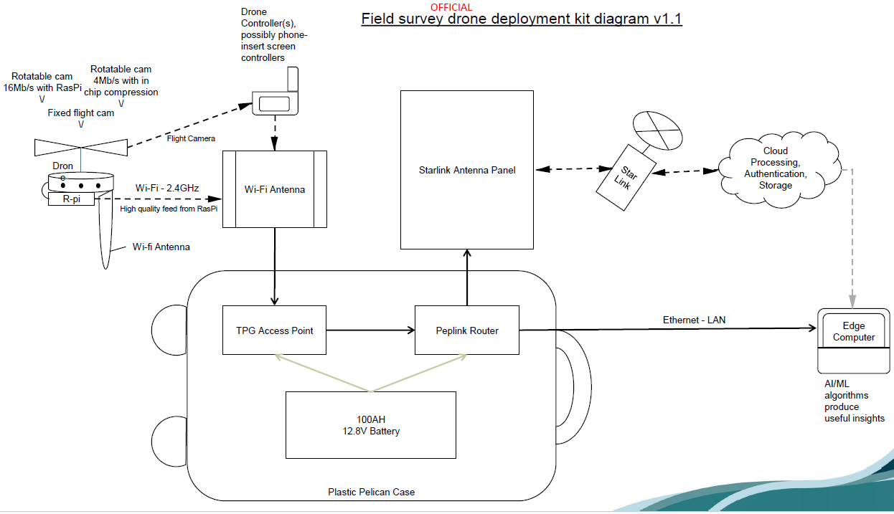

Slide 5
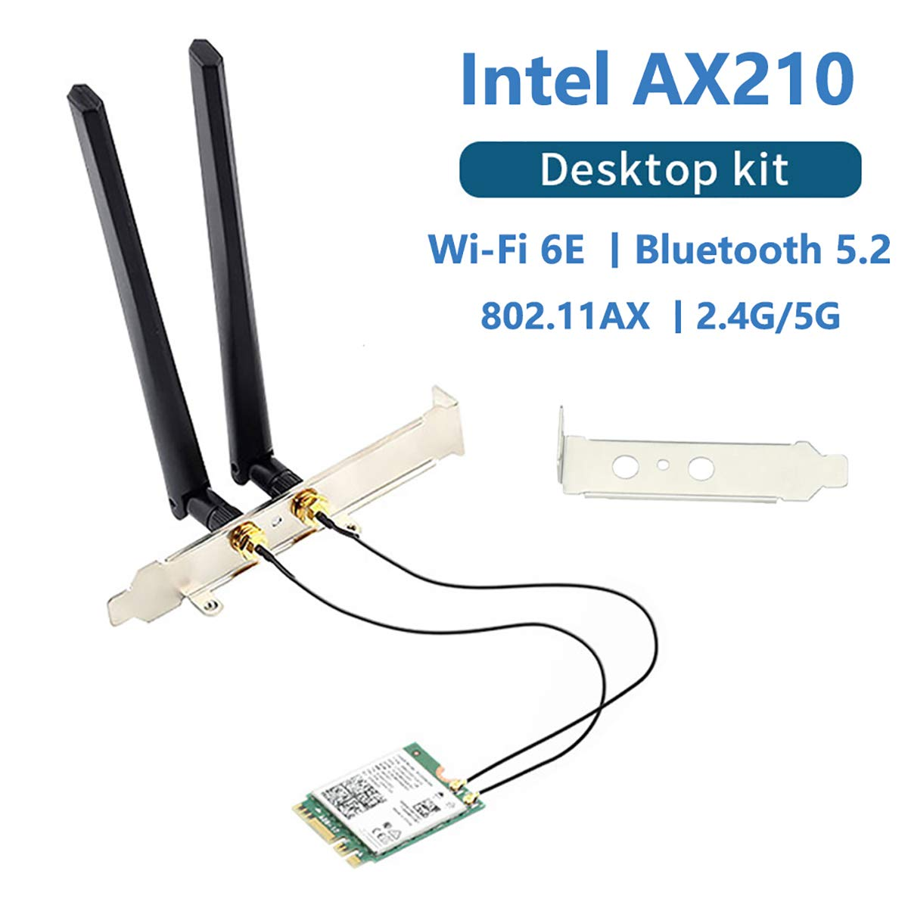

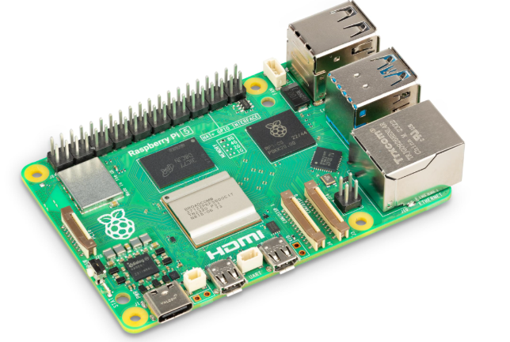
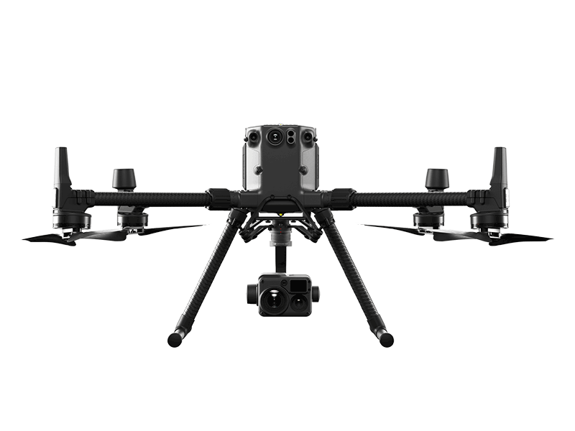
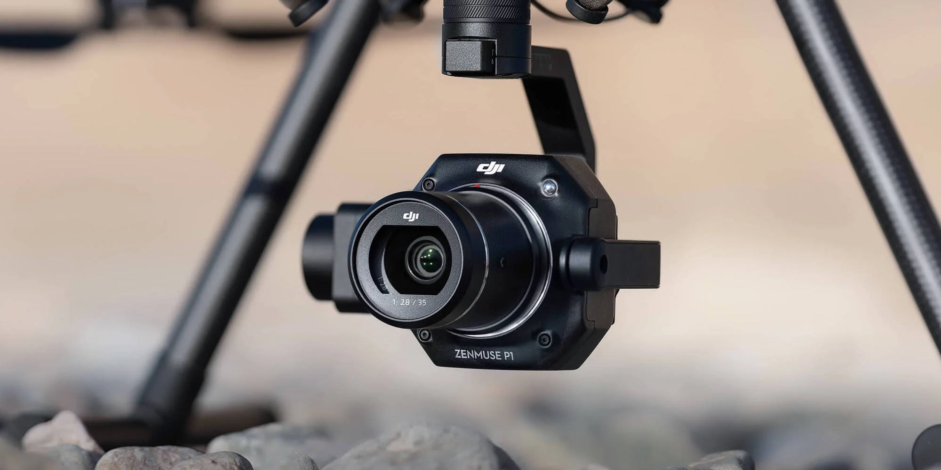
802.11 WIFI
CGNAT (IPv4)
PCIE
USB-Bulk
UART
PCIE

Slide 6
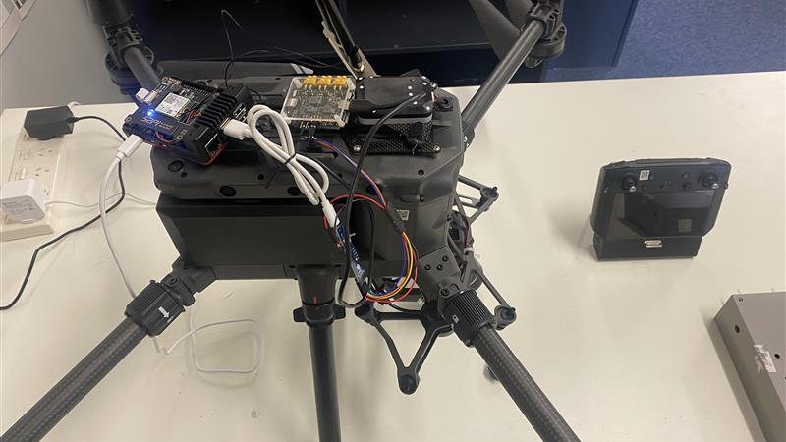
WIFI 6E Antenna
Raspberry Pi 5
DJI E-port
OSDK/PSDK Port
USB-Bulk Connection
Serial Port Connection

Slide 7
Subtask 1: DJI SDK Integration & Image Retrieval
Setup & Implementation:
Installed & compiled DJI PSDK & OSDK on Raspberry Pi
Established stable real-time communication with DJI M300 RTK
Developed C++ application for:
Real-time image retrieval from ZENMUSE P1 SD card
Automated storage & processing pipeline

Slide 8
Subtask 2: Real-Time Data Transmission & Cloud Integration
Automated Data Pipeline:
Monitor & detect new images on DJI P1 SD card
Retrieve images in real-time while the drone is flying
Upload images to Pawsey S3 storage
Ensure data integrity & transmission validation

Slide 9
Subtask 3: Software Packaging & Deployment
C++ Software Development:
Fully compiled into a standalone executable for direct execution on Raspberry Pi
Optimized for high-performance real-time processing
Docker-Based Containerization:
Ensures portability & reproducibility
Pre-packaged with all dependencies
Compatible across multiple Raspberry Pi devices

Slide 10
Subtask 4: Software Packaging & Deployment
Enhancements Implemented:
Wi-Fi 6 Optimization → Reduced latency for high-speed transmission
Error Handling Mechanisms → Implemented automatic retries & failure recovery
Robust Logging System → Monitors:
Image retrieval success rates
Network stability & data transmission efficiency
System failures & debugging insights

Slide 11
Thank you

